Slide 1
Big Mountain Resort
Pricing Model

Slide 2
Problem Identification
Big Mountain Resort currently prices ski tickets at $81.00 per person, for both weekdays and weekends.
A data driven approach is desired to improve upon the current method of pricing based on the market average.
Data on 300 competitor ski resorts across North America can be leveraged using a modeling approach comparing different features, facilities and properties of each resort.
How can Big Mountain Resort maximize profits this season by optimizing ticket prices and resort facilities?

Slide 3
Recommendation and Key Findings
Ticket price should be increased by $1.99 while increasing the vertical drop of the resort by 150 feet. The recently purchased chair lift will serve a new run to accommodate the vertical drop increase.
Model suggests profit can be increased by up to $2 million this season
Future work could be done to test feasibility of improving profit by reducing costs, but additional data on costs of facilities would be needed.

Slide 4
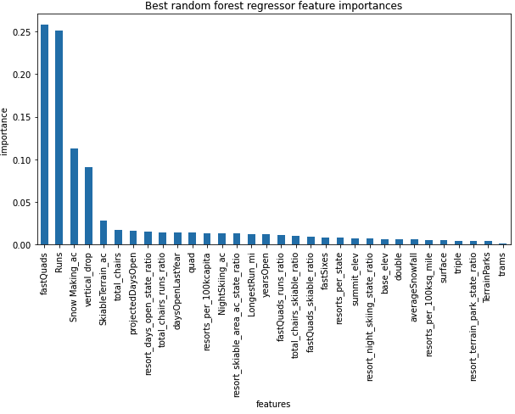
Modeling Results and Analysis
Random forest regression model
Top 4 features driving ticket price:
Fast Quad Chairs
# of Runs
Snow Making Area
Vertical Drop

Slide 5
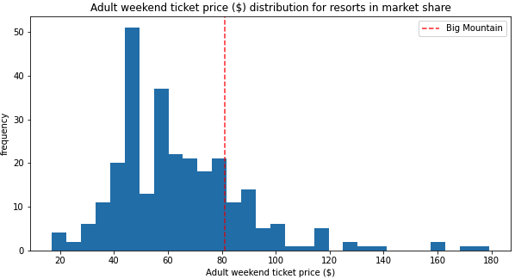
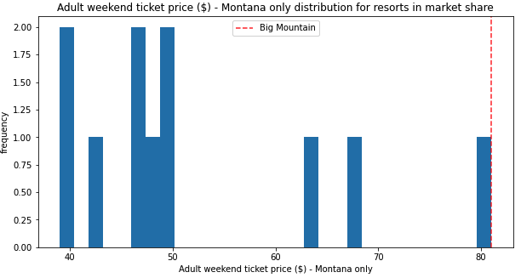
Ticket Prices
Big Mountain is the highest priced resort in Montana, and among the higher priced resorts in North America.

Slide 6
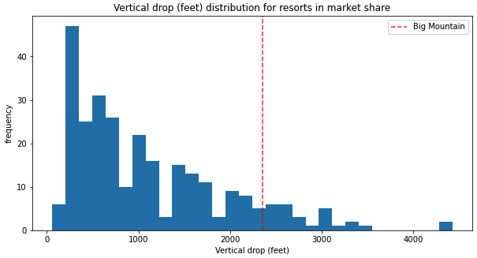
Best Modelling Scenario
Several modelling scenarios were explored that added vertical drop, runs, and snowmaking area.
The best model tested added 1 run and 150 feet of vertical drop. Big Mountain is near the top of competitors with snowmaking area, but has some room for improvement with vertical drop.

Slide 7
Summary and Conclusion
Big Mountain Resort should add a run this season while increasing vertical drop by 150 feet.
Increased profits up to $2 million estimated using recommended scenario.
Future modeling work could be done to test facilities cost-cutting scenarios, but additional data on facilities costs is needed.

